Slide 1

DISCLAIMER
The information in this presentation is provided to you by PT. AXAR Technology Raya, solely for informational purposes and does not constitute an offer to buy, sell or issue, or a solicitation of an offer to sell, buy or acquire any securities of the Company in any jurisdiction or an inducement to enter into investment activity, nor may it or any part of it form the basis of or be relied on in connection with any contract or commitment whatsoever. No representations or warranties, express or implied, are made by the Company, any underwriters, any of their respective affiliates, directors, officers, employees, advisors or representatives with respect to, and no reliance should be placed, on the accuracy, fairness or completeness of the information presented or contained in this presentation. By viewing this presentation, you agree that none of the Company, any underwriters, nor any of their respective affiliates, directors, officers, employees, advisors or representatives accepts any responsibility or liability whatsoever for any loss howsoever arising from any information presented or contained in or derived from or omitted from this presentation. The information presented or contained in this presentation was obtained from various sources, including certain third parties, and has not been independently verified, and its accuracy is not guaranteed.
This presentation does not contain all relevant information relating to the Company or its securities, particularly with respect to the risks and special considerations involved with an investment in the securities of the Company. These materials are not an offer of securities for sale. Any public offering will be made by means of a prospectus that may be obtained from the issuer and that will contain detailed information about the company and management, as well as financial statements. This presentation speaks as of its date and the information presented or contained in this presentation is subject to change without notice or update.
This presentation contains statements that constitute forward-looking statements. These statements include descriptions regarding the intent, belief or current expectations of the Company or its officers about the future. These statements can be recognized by the use of words such as “expects,” “plans,” “will,” “estimates,” “projects,” “intends,” or words of similar meaning. Such forward-looking statements are not guarantees of future performance and involve risks and uncertainties, and actual results may differ from those in the forward-looking statements as a result of various factors and assumptions, many of which are beyond the Company’s control. The Company or any of its affiliates, advisors, representatives or underwriters has no obligation and does not undertake to revise forward-looking statements to reflect future events or circumstances.
THE INFORMATION CONTAINED IN THIS DOCUMENT IS HIGHLY CONFIDENTIAL AND MAY NOT BE FORWARDED, PUBLISHED OR DISTRIBUTED, DIRECTLY OR INDIRECTLY, TO ANY OTHER PERSON (WHETHER WITHIN OR OUTSIDE YOUR ORGANIZATION/FIRM) FOR ANY PURPOSE AND MAY NOT BE REPRODUCED IN ANY MANNER WHATSOEVER. ANY FORWARDING, PUBLICATION, DISTRIBUTION OR REPRODUCTION OF THIS DOCUMENT IN WHOLE OR IN PART IS UNAUTHORIZED.
MOBILE
DEVELOPMENT
DAY 1

Slide 2
OBJECTIVES
Pengenalan Flutter
Instalasi Flutter & Android Studio
Setup dan konfigurasi
My First App
Widget Catalog
Notes:
Save Time....:
The Platform will house/aggregate thousands of DIRECT SUPPLIERS. Buyer members are now abled to easily Pick whats best suitable for them.
Discover...:
Suppliers need to be a registered and verified members. There will be features such as ratings and certifications to boost further.
Grow Business:
Members akan di-empowered dengan sebuah tool digital yang yang tadinya menyerang industri, malah justru membuat mereka bisa menjadi lebih kompetitif di era digital.

Slide 3
Pengenalan Flutter
Flutter adalah sebuah framework open-source yang dikembangkan oleh Google untuk membangun antarmuka (user interface/UI) aplikasi Android dan iOS.
Flutter memiliki fitur hot reload yang dimana fitur tersebut dapat menampilkan perubahan yang dilakukan tanpa men-kompilasi atau mem-build ulang program.
Flutter menggunakan bahasa pemograman dart
Hamilton dan Alibaba adalah dua dari beberapa perusahaan yang telah menggunakan teknologi flutter.
Notes:
Save Time....:
The Platform will house/aggregate thousands of DIRECT SUPPLIERS. Buyer members are now abled to easily Pick whats best suitable for them.
Discover...:
Suppliers need to be a registered and verified members. There will be features such as ratings and certifications to boost further.
Grow Business:
Members akan di-empowered dengan sebuah tool digital yang yang tadinya menyerang industri, malah justru membuat mereka bisa menjadi lebih kompetitif di era digital.

Slide 4

Instatlasi Flutter & Android Studio
Persiapan :
1. Install Android Studio (JDK dan SDK sudah terinstall otomatis)
2. Install Flutter
Silahkan download android studio pada link berikut :
https://developer.android.com/studio
Silahkan klik tombol download seperti gambar diatas.
Penting : Karna ukuran file yang cukup besar, harap perserta telah mendownload seluruh persiapan sebelum pertemuan.
Notes:
Save Time....:
The Platform will house/aggregate thousands of DIRECT SUPPLIERS. Buyer members are now abled to easily Pick whats best suitable for them.
Discover...:
Suppliers need to be a registered and verified members. There will be features such as ratings and certifications to boost further.
Grow Business:
Members akan di-empowered dengan sebuah tool digital yang yang tadinya menyerang industri, malah justru membuat mereka bisa menjadi lebih kompetitif di era digital.

Slide 5
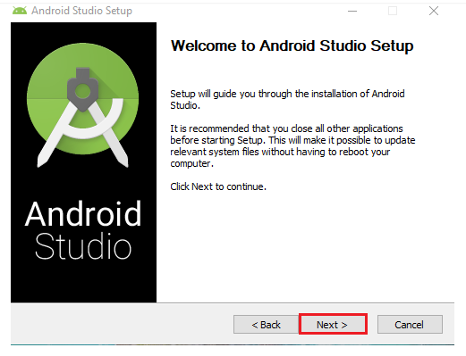
Instatlasi Flutter & Android Studio
setelah mendownload installer, silahkan ikuti langkah berikut :
Klik, next.
Notes:
Save Time....:
The Platform will house/aggregate thousands of DIRECT SUPPLIERS. Buyer members are now abled to easily Pick whats best suitable for them.
Discover...:
Suppliers need to be a registered and verified members. There will be features such as ratings and certifications to boost further.
Grow Business:
Members akan di-empowered dengan sebuah tool digital yang yang tadinya menyerang industri, malah justru membuat mereka bisa menjadi lebih kompetitif di era digital.

Slide 6
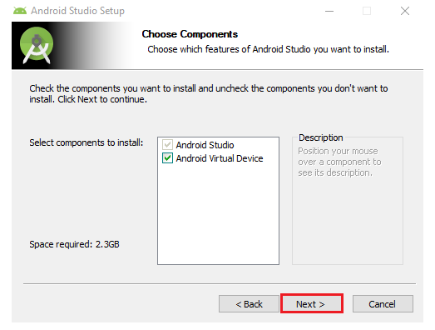
Instatlasi Flutter & Android Studio
Silahkan uncheck Android Virtual Device jika tidak digunakan
klik next.
Notes:
Save Time....:
The Platform will house/aggregate thousands of DIRECT SUPPLIERS. Buyer members are now abled to easily Pick whats best suitable for them.
Discover...:
Suppliers need to be a registered and verified members. There will be features such as ratings and certifications to boost further.
Grow Business:
Members akan di-empowered dengan sebuah tool digital yang yang tadinya menyerang industri, malah justru membuat mereka bisa menjadi lebih kompetitif di era digital.

Slide 7
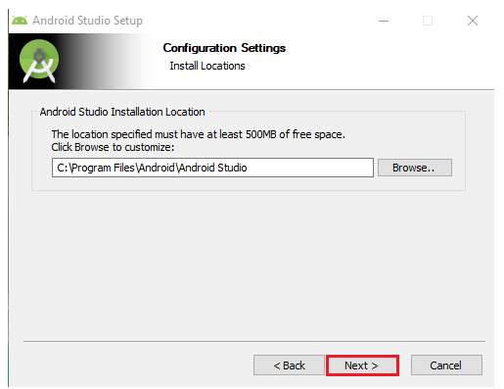
Instatlasi Flutter & Android Studio
Tentukan lokasi penyimpan file android studio
Notes:
Save Time....:
The Platform will house/aggregate thousands of DIRECT SUPPLIERS. Buyer members are now abled to easily Pick whats best suitable for them.
Discover...:
Suppliers need to be a registered and verified members. There will be features such as ratings and certifications to boost further.
Grow Business:
Members akan di-empowered dengan sebuah tool digital yang yang tadinya menyerang industri, malah justru membuat mereka bisa menjadi lebih kompetitif di era digital.

Slide 8
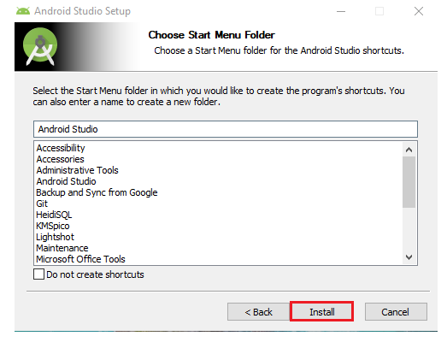
Instatlasi Flutter & Android Studio
Silahkan buat shortcut pada start menu windows, silahkan check jika tidak diinginkan
Klik install dan tunggu proses instalasi selesai.
Penting : saat proses instalasi pastikan komputer / laptop anda terhubung dengan internet. Hal tersebut dibutuhkan karena saat proses instalasi secara otomatis akan mendownload dan menginstall JDK dan SDK yang dibutuhkan.
Notes:
Save Time....:
The Platform will house/aggregate thousands of DIRECT SUPPLIERS. Buyer members are now abled to easily Pick whats best suitable for them.
Discover...:
Suppliers need to be a registered and verified members. There will be features such as ratings and certifications to boost further.
Grow Business:
Members akan di-empowered dengan sebuah tool digital yang yang tadinya menyerang industri, malah justru membuat mereka bisa menjadi lebih kompetitif di era digital.

Slide 9
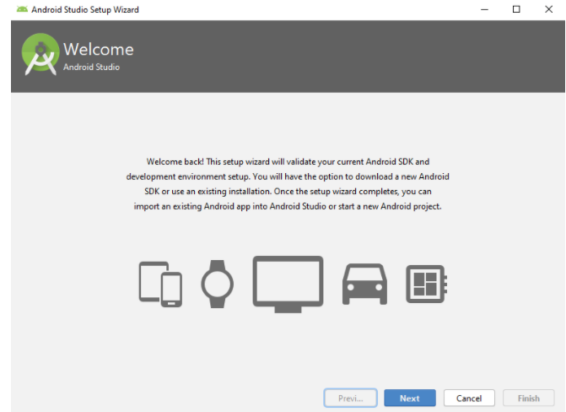
Setup dan Konfigurasi : Android Studio
Setelah selesai mengintall, buka aplikasi android studio. Lanjutkan dengan klik next.
Notes:
Save Time....:
The Platform will house/aggregate thousands of DIRECT SUPPLIERS. Buyer members are now abled to easily Pick whats best suitable for them.
Discover...:
Suppliers need to be a registered and verified members. There will be features such as ratings and certifications to boost further.
Grow Business:
Members akan di-empowered dengan sebuah tool digital yang yang tadinya menyerang industri, malah justru membuat mereka bisa menjadi lebih kompetitif di era digital.

Slide 10
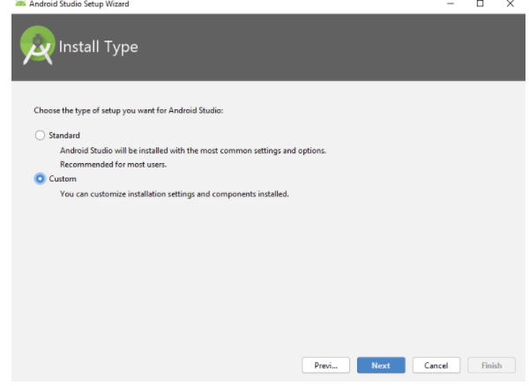
Setup dan Konfigurasi : Android Studio
Silahkan pilih setup standart. Klik Next.
Notes:
Save Time....:
The Platform will house/aggregate thousands of DIRECT SUPPLIERS. Buyer members are now abled to easily Pick whats best suitable for them.
Discover...:
Suppliers need to be a registered and verified members. There will be features such as ratings and certifications to boost further.
Grow Business:
Members akan di-empowered dengan sebuah tool digital yang yang tadinya menyerang industri, malah justru membuat mereka bisa menjadi lebih kompetitif di era digital.

Slide 11
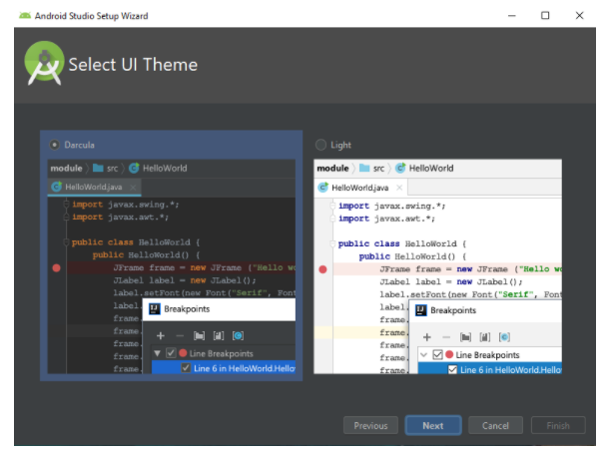
Setup dan Konfigurasi : Android Studio
Silahkan pilih tema tampilan aplikasi android studio.
Notes:
Save Time....:
The Platform will house/aggregate thousands of DIRECT SUPPLIERS. Buyer members are now abled to easily Pick whats best suitable for them.
Discover...:
Suppliers need to be a registered and verified members. There will be features such as ratings and certifications to boost further.
Grow Business:
Members akan di-empowered dengan sebuah tool digital yang yang tadinya menyerang industri, malah justru membuat mereka bisa menjadi lebih kompetitif di era digital.

Slide 12
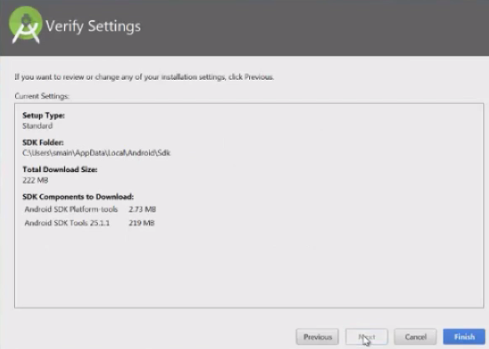
Setup dan Konfigurasi : Android Studio
df
Silahkan klik finish dan tunggu proses hingga selesai.
Penting : sekali lagi pastikan laptop/komputer anda telah terhubung dengan internet.
Notes:
Save Time....:
The Platform will house/aggregate thousands of DIRECT SUPPLIERS. Buyer members are now abled to easily Pick whats best suitable for them.
Discover...:
Suppliers need to be a registered and verified members. There will be features such as ratings and certifications to boost further.
Grow Business:
Members akan di-empowered dengan sebuah tool digital yang yang tadinya menyerang industri, malah justru membuat mereka bisa menjadi lebih kompetitif di era digital.

Slide 13
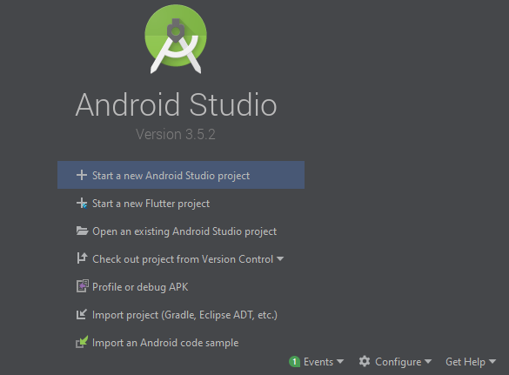
Setup dan Konfigurasi : Android Studio
df
Setelah seluruh proses selesai. Silahkan buka aplikasi android studio dan akan muncul tampilan seperti dibawah ini.
Silahkan Klik Configure, yang ditunjuk oleh panah biru.
Notes:
Save Time....:
The Platform will house/aggregate thousands of DIRECT SUPPLIERS. Buyer members are now abled to easily Pick whats best suitable for them.
Discover...:
Suppliers need to be a registered and verified members. There will be features such as ratings and certifications to boost further.
Grow Business:
Members akan di-empowered dengan sebuah tool digital yang yang tadinya menyerang industri, malah justru membuat mereka bisa menjadi lebih kompetitif di era digital.

Slide 14
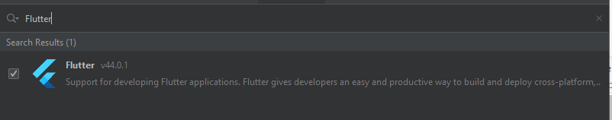
Setup dan Konfigurasi : Android Studio
df
Kemudian pilih plugin dan ketik flutter pada bagian search.
Klik tulisan flutter, dan klik install pada sudu
Notes:
Save Time....:
The Platform will house/aggregate thousands of DIRECT SUPPLIERS. Buyer members are now abled to easily Pick whats best suitable for them.
Discover...:
Suppliers need to be a registered and verified members. There will be features such as ratings and certifications to boost further.
Grow Business:
Members akan di-empowered dengan sebuah tool digital yang yang tadinya menyerang industri, malah justru membuat mereka bisa menjadi lebih kompetitif di era digital.

Slide 15

Setup dan Konfigurasi : VS Code
df
Setelah melakukan setup dan konfigurasi pada android studio. silahkan lakukan langkah berikut jika ingin pengembangan aplikasi di VS Code.
IDE VS Code adalah rekomendasi karna lebih ringan untuk digunakan.
Silahkan klik logo extension disamping kiri.
Ketikkan flutter pada kolom search. Kemudian pilih dan install.
Notes:
Save Time....:
The Platform will house/aggregate thousands of DIRECT SUPPLIERS. Buyer members are now abled to easily Pick whats best suitable for them.
Discover...:
Suppliers need to be a registered and verified members. There will be features such as ratings and certifications to boost further.
Grow Business:
Members akan di-empowered dengan sebuah tool digital yang yang tadinya menyerang industri, malah justru membuat mereka bisa menjadi lebih kompetitif di era digital.

Slide 16

Setup dan Konfigurasi : Flutter
df
Silahkan download SDK Flutter pada link berikut :
https://flutter.dev/docs/get-started/install/windows
Kemudian silahkan klik tombol biru seperti gambar diatas untuk mendownload SDK Flutter.
Kemudian silahkan extract file yang telah didownload pada lokasi yang diinginkan.
Untuk mempermudah pembelajaran silahkan buat lokasi file dengan seragam sebagai berikut :
C:\src\flutter
Notes:
Save Time....:
The Platform will house/aggregate thousands of DIRECT SUPPLIERS. Buyer members are now abled to easily Pick whats best suitable for them.
Discover...:
Suppliers need to be a registered and verified members. There will be features such as ratings and certifications to boost further.
Grow Business:
Members akan di-empowered dengan sebuah tool digital yang yang tadinya menyerang industri, malah justru membuat mereka bisa menjadi lebih kompetitif di era digital.

Slide 17
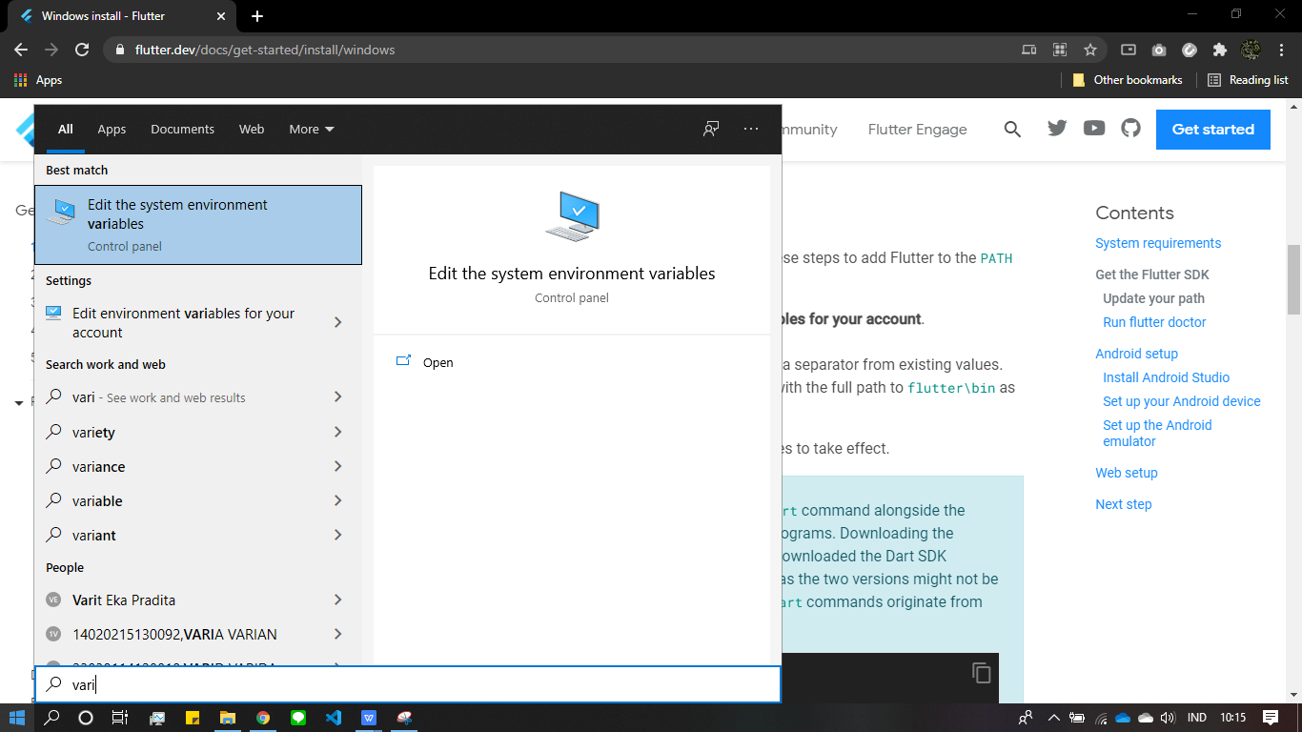
Setup dan Konfigurasi : Flutter
df
Kemudian klik tombol windows pada sudut kiri bawah layar komputer anda
ketikkan dan pilih edit the system environment variables
Notes:
Save Time....:
The Platform will house/aggregate thousands of DIRECT SUPPLIERS. Buyer members are now abled to easily Pick whats best suitable for them.
Discover...:
Suppliers need to be a registered and verified members. There will be features such as ratings and certifications to boost further.
Grow Business:
Members akan di-empowered dengan sebuah tool digital yang yang tadinya menyerang industri, malah justru membuat mereka bisa menjadi lebih kompetitif di era digital.

Slide 18
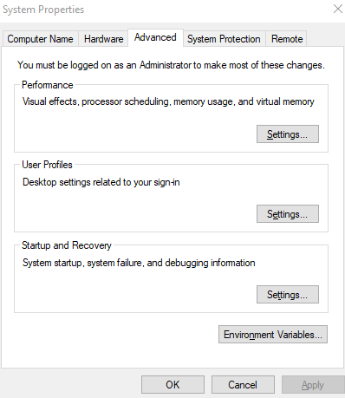
Setup dan Konfigurasi : Flutter
df
Kemudian Klik Environment variable.
Notes:
Save Time....:
The Platform will house/aggregate thousands of DIRECT SUPPLIERS. Buyer members are now abled to easily Pick whats best suitable for them.
Discover...:
Suppliers need to be a registered and verified members. There will be features such as ratings and certifications to boost further.
Grow Business:
Members akan di-empowered dengan sebuah tool digital yang yang tadinya menyerang industri, malah justru membuat mereka bisa menjadi lebih kompetitif di era digital.

Slide 19
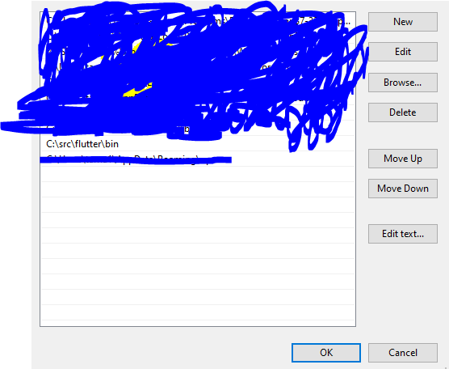
Setup dan Konfigurasi : Flutter
df
Kemudian klik baris path dan klik tombol edit.
akan muncul tampilan seperti berikut :
Kemudian klik tombol new, dan isi dengan alamat C:\src\flutter\bin
Notes:
Save Time....:
The Platform will house/aggregate thousands of DIRECT SUPPLIERS. Buyer members are now abled to easily Pick whats best suitable for them.
Discover...:
Suppliers need to be a registered and verified members. There will be features such as ratings and certifications to boost further.
Grow Business:
Members akan di-empowered dengan sebuah tool digital yang yang tadinya menyerang industri, malah justru membuat mereka bisa menjadi lebih kompetitif di era digital.

Slide 20
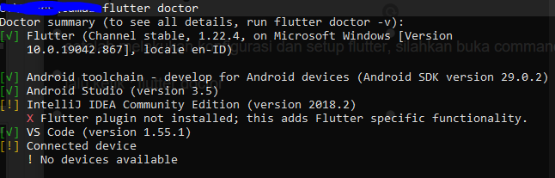
Setup dan Konfigurasi : Flutter
df
setelah melakukan konfigurasi dan setup flutter, silahkan buka command prompt atau cmd
lalu ketik : flutter doctor
perintah tersebut akan melakukan pengecekkan terhadap aplikasi yang terfigurasi, versi flutter, android licence dan connected device.
Notes:
Save Time....:
The Platform will house/aggregate thousands of DIRECT SUPPLIERS. Buyer members are now abled to easily Pick whats best suitable for them.
Discover...:
Suppliers need to be a registered and verified members. There will be features such as ratings and certifications to boost further.
Grow Business:
Members akan di-empowered dengan sebuah tool digital yang yang tadinya menyerang industri, malah justru membuat mereka bisa menjadi lebih kompetitif di era digital.

Slide 21
Setup dan Konfigurasi : Flutter
df
Pada bagian awal tentunya akan mendapatkan masalah dibagian android licence ketika di cek menggunakan flutter doctor. Hal tersebut terjadi karna pengembangang belum menerima licence dari android.
Hal tersebut dapat diselesaikan dengan mengetik perintah berikut pada cmd :
flutter doctor --android-licenses
kemudian ketik y untuk menerima setiap license androidnya.
Notes:
Save Time....:
The Platform will house/aggregate thousands of DIRECT SUPPLIERS. Buyer members are now abled to easily Pick whats best suitable for them.
Discover...:
Suppliers need to be a registered and verified members. There will be features such as ratings and certifications to boost further.
Grow Business:
Members akan di-empowered dengan sebuah tool digital yang yang tadinya menyerang industri, malah justru membuat mereka bisa menjadi lebih kompetitif di era digital.

Slide 22
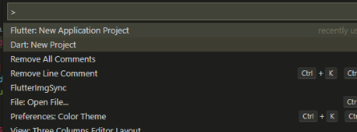
My First App
df
Untuk setelah berhasil melakukan setup dan konfigurasi, silahkan membuka VS Code untuk membuat project flutter.
Silahkan ketik Ctrl + SHIFT + P,
Kemudian ketik Flutter dan pilih Flutter : New Application Project,
Setelah itu silahkan pilih direktori penyimpanan project
Notes:
Save Time....:
The Platform will house/aggregate thousands of DIRECT SUPPLIERS. Buyer members are now abled to easily Pick whats best suitable for them.
Discover...:
Suppliers need to be a registered and verified members. There will be features such as ratings and certifications to boost further.
Grow Business:
Members akan di-empowered dengan sebuah tool digital yang yang tadinya menyerang industri, malah justru membuat mereka bisa menjadi lebih kompetitif di era digital.

Slide 23
My First App
df
Setelah memilih direktori, silahkan ketik nama project anda pada kolom input yang tersedia.
Tekan Enter, VS Code akan memproses pembuatan project.
Pada awal pembuatan project, kita telah diberikan kode default yang merupakan contoh program sederhana aplikasi Flutter.
Konfigurasikan smartphone anda menjadi mode pengembang :
Settingan mode pengembang pada setiap HP berbeda-beda. Namun pada umumnya settingan tersebut terdapat pada halaman berikut :
Pengaturan => My Device => Parameters => Software Version.
Jika mengalami kesulitan pada tahap ini, silahkan meminta bantuan pada mentor.
ketika HP sudah dalam mode pengembang, silahkan melakukan debug aplikasi pada smartphone kita, Silahkan buka terminal. Ketik flutter run pada terminal dan tunggu proses build hingga selesai.
Notes:
Save Time....:
The Platform will house/aggregate thousands of DIRECT SUPPLIERS. Buyer members are now abled to easily Pick whats best suitable for them.
Discover...:
Suppliers need to be a registered and verified members. There will be features such as ratings and certifications to boost further.
Grow Business:
Members akan di-empowered dengan sebuah tool digital yang yang tadinya menyerang industri, malah justru membuat mereka bisa menjadi lebih kompetitif di era digital.

Slide 24
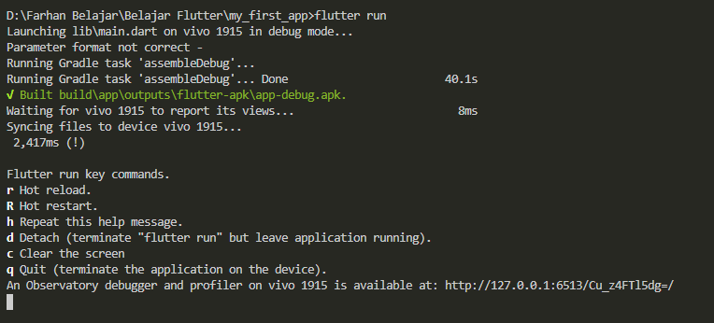
My First App
df
Ketika proses build selesai, console pada termintal akan menampilkan seperti gambar berikut :
Pada awal build debug program kita telah diberikan beberapa key untuk melakukan fitur-fitur yang tertera, seperti hot reload dan lain-lain.
Notes:
Save Time....:
The Platform will house/aggregate thousands of DIRECT SUPPLIERS. Buyer members are now abled to easily Pick whats best suitable for them.
Discover...:
Suppliers need to be a registered and verified members. There will be features such as ratings and certifications to boost further.
Grow Business:
Members akan di-empowered dengan sebuah tool digital yang yang tadinya menyerang industri, malah justru membuat mereka bisa menjadi lebih kompetitif di era digital.

Slide 25
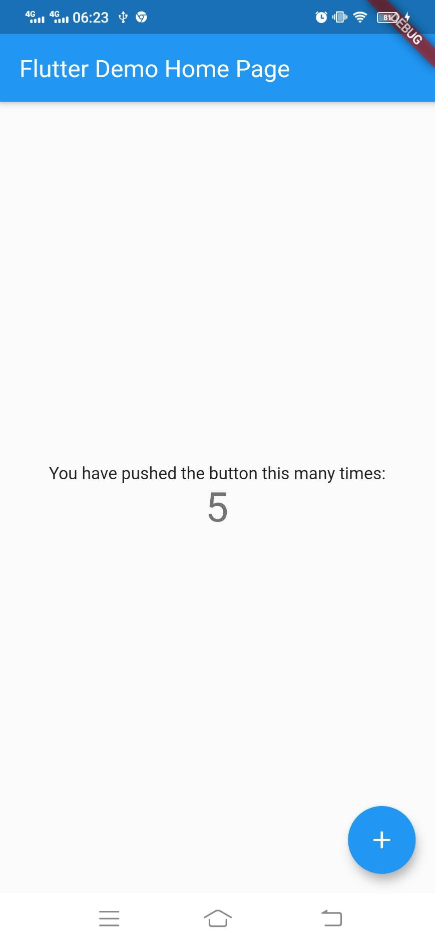
My First App
df
Setelah berhasil melakukan build debug aplikasi, aplikasi versi debug akan terinstall di dalam HP. Pada tampilan default flutter membuat program aplikasi counter. Pada program tersebut kita dapat klik tombol biru yang tertera untuk menambah bilangan di tengah layar.
Notes:
Save Time....:
The Platform will house/aggregate thousands of DIRECT SUPPLIERS. Buyer members are now abled to easily Pick whats best suitable for them.
Discover...:
Suppliers need to be a registered and verified members. There will be features such as ratings and certifications to boost further.
Grow Business:
Members akan di-empowered dengan sebuah tool digital yang yang tadinya menyerang industri, malah justru membuat mereka bisa menjadi lebih kompetitif di era digital.

Slide 26
My First App
df
Agar program dapat dijelaskan dengan lebih baik, program telah di upload ke github yang dapat diiakses dari link berikut :
[isi link]
Pada program tersebut, silahkan peserta terlebih dahulu menghapus seluruh komen agar lebih mudah untuk diperhatikan.
Ada beberapa bagian yang sangat perlu di perhatikan pada program tersebut :
1. Widget
2. class MyApp extends StatelessWidget
3. class MyHomePage extends StatefullWidget
4. setState
Notes:
Save Time....:
The Platform will house/aggregate thousands of DIRECT SUPPLIERS. Buyer members are now abled to easily Pick whats best suitable for them.
Discover...:
Suppliers need to be a registered and verified members. There will be features such as ratings and certifications to boost further.
Grow Business:
Members akan di-empowered dengan sebuah tool digital yang yang tadinya menyerang industri, malah justru membuat mereka bisa menjadi lebih kompetitif di era digital.

Slide 27
My First App
df
1. Widget
Widget adalah Semua komponen yang membentuk sebuah tampilan atau kerangka aplikasi. Keseluruhan dari aplikasi yang terlihat pada layar merupakan kumpulan widget. contoh text, button, dll.
Seluruh text pada tampilan aplikasi di samping merupakan widget dengan Class Text
Tombol pada bagian bawah kanan merupakan widget dengan class FloatingActionButton
Bar pada bagian atas aplikasi juga merupakan widget dengan class AppBar
Notes:
Save Time....:
The Platform will house/aggregate thousands of DIRECT SUPPLIERS. Buyer members are now abled to easily Pick whats best suitable for them.
Discover...:
Suppliers need to be a registered and verified members. There will be features such as ratings and certifications to boost further.
Grow Business:
Members akan di-empowered dengan sebuah tool digital yang yang tadinya menyerang industri, malah justru membuat mereka bisa menjadi lebih kompetitif di era digital.

Slide 28
My First App
df
2. class MyApp extends StatelessWidget
MyApp merupakan sebuah kelas dengan nama MyApp dan memiliki induk atau parent Stateless Widget.
Pada dasarnya StatelessWidget digunakan untuk widget yang bersifat statis yang berarti tidak akan ada widget yang mengalami perubahan pada kelas tersebut.
Pada program dapat kita lihat bahwa title yang berada pada appbar tidak akan berubah baik tulisan judul dan warna tema aplikasi tersebut. Oleh karena itu, class tersebut dibuat menjadi stateless.
Notes:
Save Time....:
The Platform will house/aggregate thousands of DIRECT SUPPLIERS. Buyer members are now abled to easily Pick whats best suitable for them.
Discover...:
Suppliers need to be a registered and verified members. There will be features such as ratings and certifications to boost further.
Grow Business:
Members akan di-empowered dengan sebuah tool digital yang yang tadinya menyerang industri, malah justru membuat mereka bisa menjadi lebih kompetitif di era digital.

Slide 29
My First App
df
3. class MyHomePage extends StatefullWidget
MyHomePage merupakan sebuah kelas dengan nama MyHomePage dan memiliki induk atau parent StatefullWidget.
Pada dasarnya StatefullWidget digunakan untuk widget yang bersifat dinamis yang berarti akan ada widget yang mengalami perubahan pada kelas tersebut.
Pada program dapat kita lihat bahwa text 0 yang berada pada center aplikasi akan berubah sesuai jumlah tombol yang ditekan. Oleh karena itu, class tersebut dibuat menjadi statefull.
Notes:
Save Time....:
The Platform will house/aggregate thousands of DIRECT SUPPLIERS. Buyer members are now abled to easily Pick whats best suitable for them.
Discover...:
Suppliers need to be a registered and verified members. There will be features such as ratings and certifications to boost further.
Grow Business:
Members akan di-empowered dengan sebuah tool digital yang yang tadinya menyerang industri, malah justru membuat mereka bisa menjadi lebih kompetitif di era digital.

Slide 30

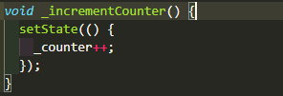
My First App
df
2. setState
setState merupakan sebuah method untuk merubah variabel yang ditampilkan pada aplikasi.
Pada program tersebut, dapat dilihat bahwa variabel _counter di tampilkan pada widget berikut :
Oleh karena itu, widget Text akan selalu mengalami perubahan ketika tombol ditekan, ketika tombol ditekan akan memanggil method _incrementCounter.
Dapat dilihat _counter++; yang merupakan syntax increment di implementasikan di dalam method setState
Notes:
Save Time....:
The Platform will house/aggregate thousands of DIRECT SUPPLIERS. Buyer members are now abled to easily Pick whats best suitable for them.
Discover...:
Suppliers need to be a registered and verified members. There will be features such as ratings and certifications to boost further.
Grow Business:
Members akan di-empowered dengan sebuah tool digital yang yang tadinya menyerang industri, malah justru membuat mereka bisa menjadi lebih kompetitif di era digital.

Slide 31
Widget Catalog
Widget Catalog merupakan sebuah katalog pada dokumentasi flutter yang berisi seluruh widget yang ada pada flutter.
widget Catalog dapat diakses melalui link berikut :
https://flutter.dev/docs/development/ui/widgets
perserta dapat mengakses link tersebut untuk melakukan observasi pada website tersebut.
Untuk lebih detailnya tentang widget akan dibahas pada pertemuan selanjutnya.
Notes:
Save Time....:
The Platform will house/aggregate thousands of DIRECT SUPPLIERS. Buyer members are now abled to easily Pick whats best suitable for them.
Discover...:
Suppliers need to be a registered and verified members. There will be features such as ratings and certifications to boost further.
Grow Business:
Members akan di-empowered dengan sebuah tool digital yang yang tadinya menyerang industri, malah justru membuat mereka bisa menjadi lebih kompetitif di era digital.

Slide 32
DISCLAIMER
The information in this presentation is provided to you by PT. AXAR Technology Raya, solely for informational purposes and does not constitute an offer to buy, sell or issue, or a solicitation of an offer to sell, buy or acquire any securities of the Company in any jurisdiction or an inducement to enter into investment activity, nor may it or any part of it form the basis of or be relied on in connection with any contract or commitment whatsoever. No representations or warranties, express or implied, are made by the Company, any underwriters, any of their respective affiliates, directors, officers, employees, advisors or representatives with respect to, and no reliance should be placed, on the accuracy, fairness or completeness of the information presented or contained in this presentation. By viewing this presentation, you agree that none of the Company, any underwriters, nor any of their respective affiliates, directors, officers, employees, advisors or representatives accepts any responsibility or liability whatsoever for any loss howsoever arising from any information presented or contained in or derived from or omitted from this presentation. The information presented or contained in this presentation was obtained from various sources, including certain third parties, and has not been independently verified, and its accuracy is not guaranteed.
This presentation does not contain all relevant information relating to the Company or its securities, particularly with respect to the risks and special considerations involved with an investment in the securities of the Company. These materials are not an offer of securities for sale. Any public offering will be made by means of a prospectus that may be obtained from the issuer and that will contain detailed information about the company and management, as well as financial statements. This presentation speaks as of its date and the information presented or contained in this presentation is subject to change without notice or update.
This presentation contains statements that constitute forward-looking statements. These statements include descriptions regarding the intent, belief or current expectations of the Company or its officers about the future. These statements can be recognized by the use of words such as “expects,” “plans,” “will,” “estimates,” “projects,” “intends,” or words of similar meaning. Such forward-looking statements are not guarantees of future performance and involve risks and uncertainties, and actual results may differ from those in the forward-looking statements as a result of various factors and assumptions, many of which are beyond the Company’s control. The Company or any of its affiliates, advisors, representatives or underwriters has no obligation and does not undertake to revise forward-looking statements to reflect future events or circumstances.
THE INFORMATION CONTAINED IN THIS DOCUMENT IS HIGHLY CONFIDENTIAL AND MAY NOT BE FORWARDED, PUBLISHED OR DISTRIBUTED, DIRECTLY OR INDIRECTLY, TO ANY OTHER PERSON (WHETHER WITHIN OR OUTSIDE YOUR ORGANIZATION/FIRM) FOR ANY PURPOSE AND MAY NOT BE REPRODUCED IN ANY MANNER WHATSOEVER. ANY FORWARDING, PUBLICATION, DISTRIBUTION OR REPRODUCTION OF THIS DOCUMENT IN WHOLE OR IN PART IS UNAUTHORIZED.
THANK YOU

